Slide 1
Factor Analysis
Applied Cognitive Science
# Class 08

Slide 2
Outline
Follow-up ideas pitch + Midterm Feel
Factor Analysis:
What is Factor Analysis?: Conceptual introduction
What is Factor Analysis?: How to implement it in R

Slide 3
Learning Objectives
Gain conceptual understanding of Factor Analysis
Implement Factor Analysis in R

Slide 4
Follow up
Class 06
Awesome ideas.
Comments on Brightspace.

Slide 5
How Are You Holding Up?
Midterm

Slide 6
Factor Analysis

Slide 7
What is Factor Analysis?
”Factor analysis is a way to take a mass of data and shrinking it to a smaller data set that is more manageable and more understandable. It’s a way to find hidden patterns, show how those patterns overlap and show what characteristics are seen in multiple patterns.” – StatisticsHowto

Slide 8
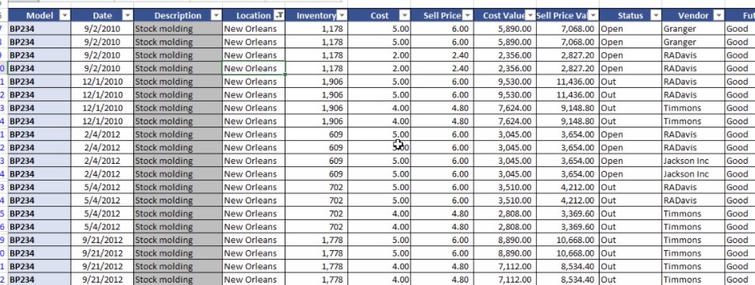
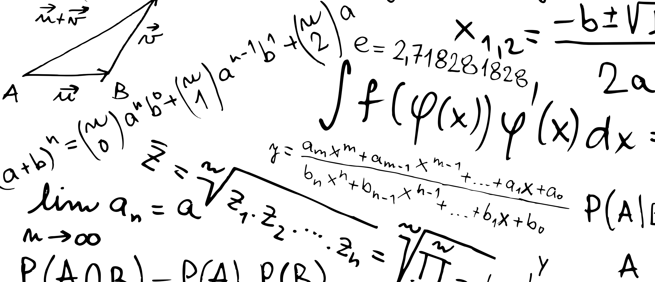
What is Factor Analysis?
Simplifying large and complex data-set by reducing number of dimensions
Many variables often describe the same variance (think correlation matrix week 1) -> Factor Analysis “explains” this pattern in detail
The idea behind factor analysis it that there are some ”latent variables" (factors) that are “hidden” that you want to uncover, instead of working with all the variables that are sort of "off-springs” (observed variables).

Slide 9
Factor Analysis – Visualised
Observed Variables
Sleep Issues
Nausia
Rumination
Hyper-ventilation
Depression
Anxiety
Confounding “hidden” Variables

Slide 10
Where do you use Factor Analysis?
Psychology
Technology
Medicine S
Field biology
Education
Examples:
Questionnaires
Personality tests
General Cognitive Abilities (IQ)
Machine Learning
Marketing Research

Slide 11
Content Overview
Body over Mind
How does biological factors influence your performance and cognition?
Mind over Body
How does our mind and cognition influence the workings of your body biological responses?
Nature vs. Nurture
How do we get the cognition that we got? What part of our geniality do we in fact owe our parents and ancestors?
Business and Pleasure
How do big companies exploit the knowledge of decision making and human pleasure? Can we exploit it ourselves?

Slide 12

Types of Factor Analysis
Exploratory Factor Analysis:
When you are exploring patterns and trends in your data-set without having prior information as to structure and dimensions.
Confirmatory Factor Analysis:
When factor analysis is used to confirm hypotheses you could have about the structure of your data.

Slide 13
Factor Analysis – Term sheet:
Varibles: The observed information
Factor: a set of observed variables that have similar response patterns
Confounding variable: a hidden variable, that are associated with factors
Dimensions: The amount of variables included in analysis
Communality (h2): proportion of a variable’s variance explained by the factor
Loadings: quantifies the extent to which the variable is related to a given factor (basically a correlation coefficient)

Slide 14
Example: Maximising Data
Ask yourself:
In what sense does it make sense to use factor analysis?
What questions do I want to answer?

Slide 15
Step by Step (in R)
1. Data pre-processing
2. Correlation Matrix
3. Find No. of Factors
4. Conduct FA analysis
5.
Inspect Loadings
6. Evaluate Model

Slide 16
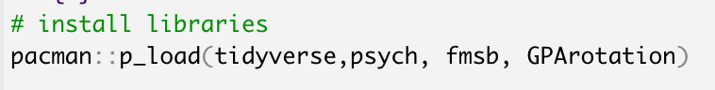
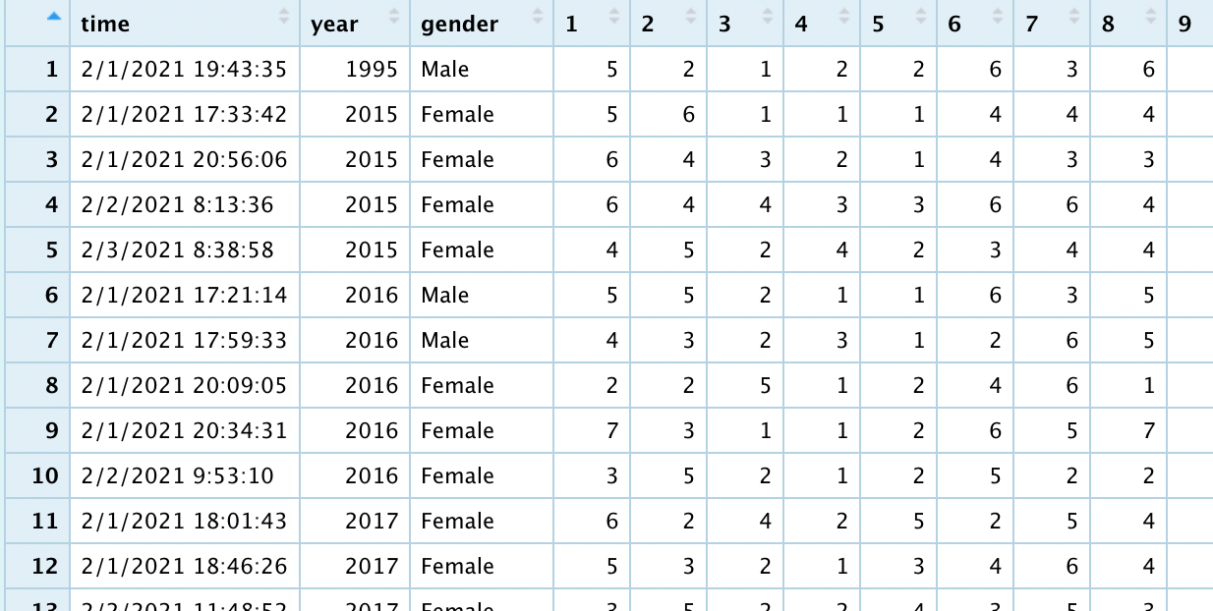
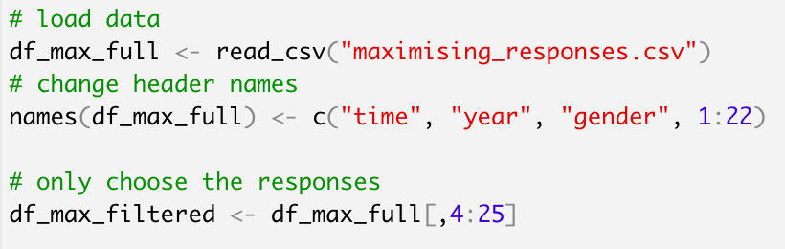
1. Data Preprocessing
FA Example: Maximising and Happiness
How is the data structured?
Remove NAs
Remove ”information” columns (e.g. demographics, timestamps etc.)

Slide 17
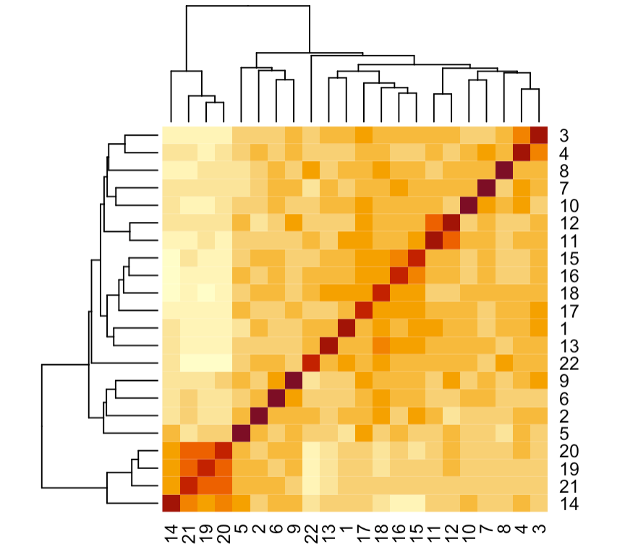
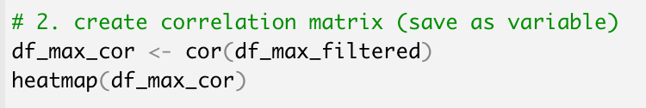
2. Make Correlation Matrix
FA Example: Maximising and Happiness
Do I see some patterns just by visual inspection?

Slide 18
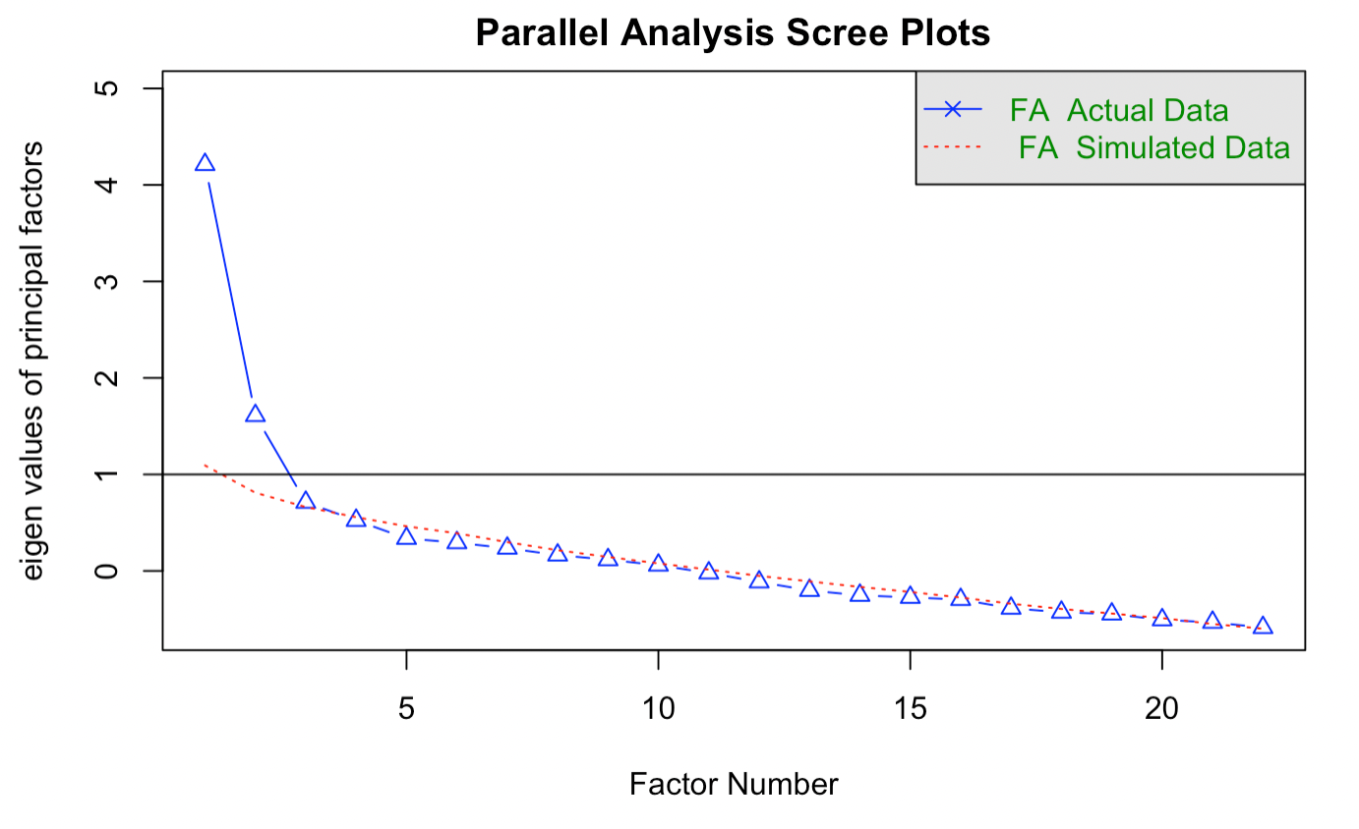
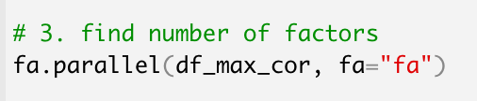
3. Find number of factors
FA Example: Maximising and Happiness

Slide 19
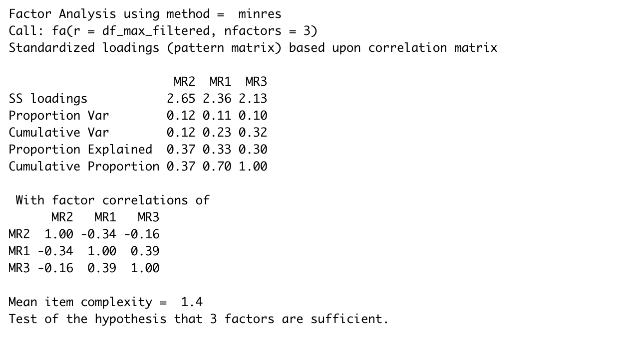
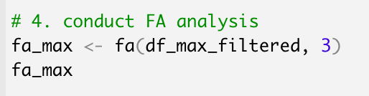
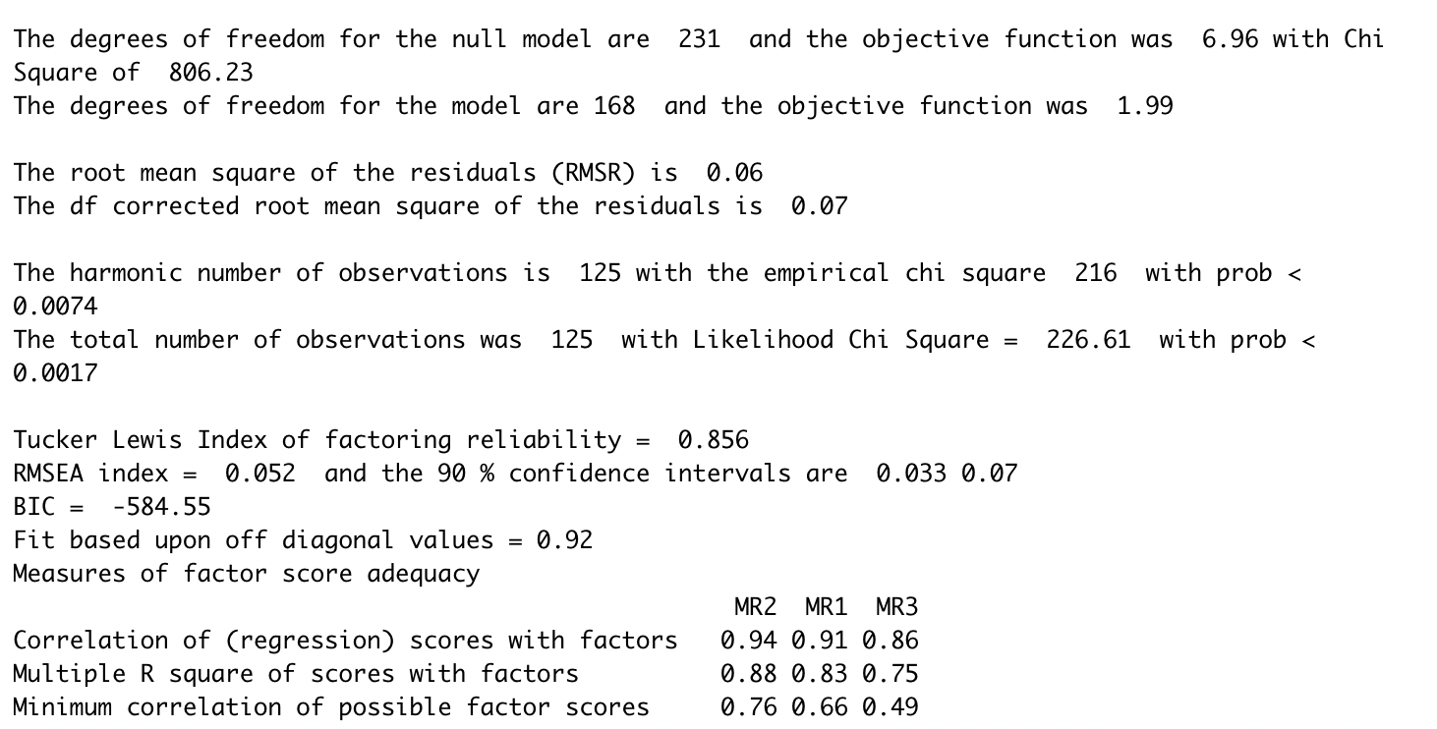
4. Conduct Analysis

Slide 20
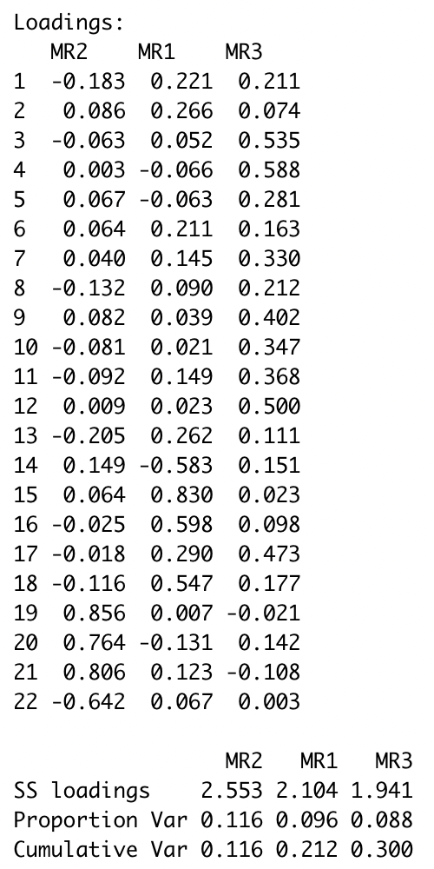
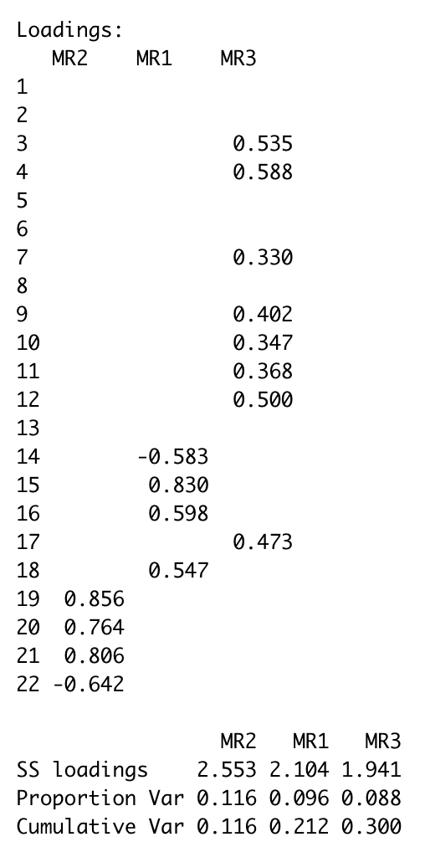
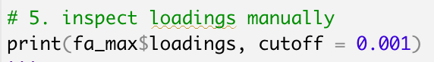
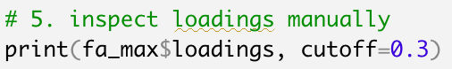
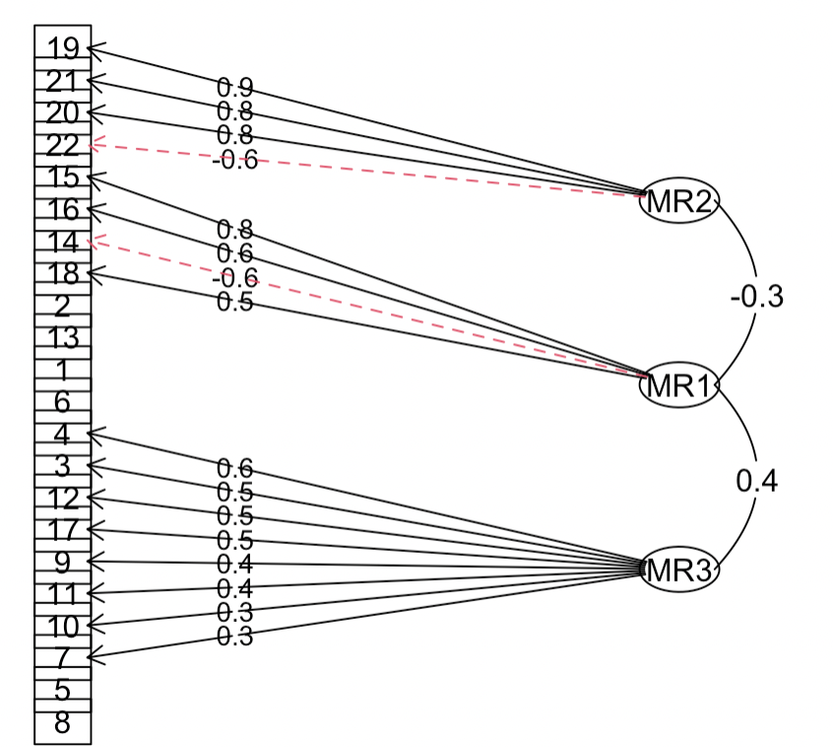
5. Inspect Loadings

Slide 21
6. Evaluate model
Evaluation by comparison to other models
No p-value to go to (get use to it :*)
Parameters to look at:
Variance Explained
BIC
… Play around ☺

Slide 22
Getting Your Hands Dirty ☺
1. Go to Brightspace/Content/Week8/Class8
2. Download Markdown
3. Submit Assignment (due 31/03)

Slide 23
Arrivederci ☺
See you at the Friday bar

